Slide 1
Data Quality Practices in Sri Lanka
Pamod Amarakoon
HISP Sri Lanka

Slide 2







RMNCAYH Digital Information System
eRHMIS
“Better Information for Better Health”
And many more…..

Slide 3
Form Designing
Identical transformation
For well-established dataflows eg. MCH
Creating a customized data entry form similar to the existing paper-based format.

Slide 4
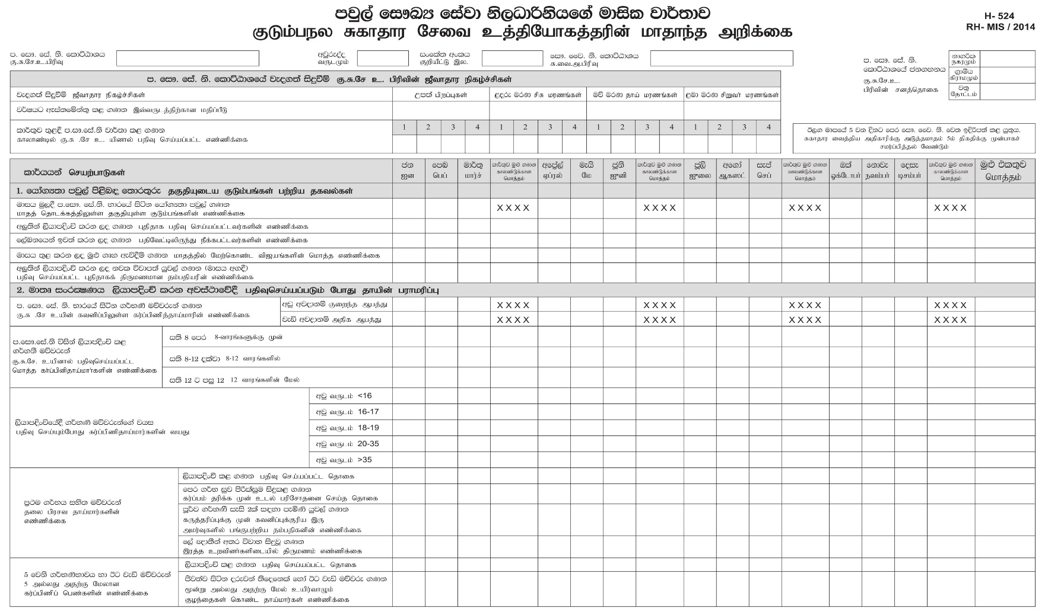
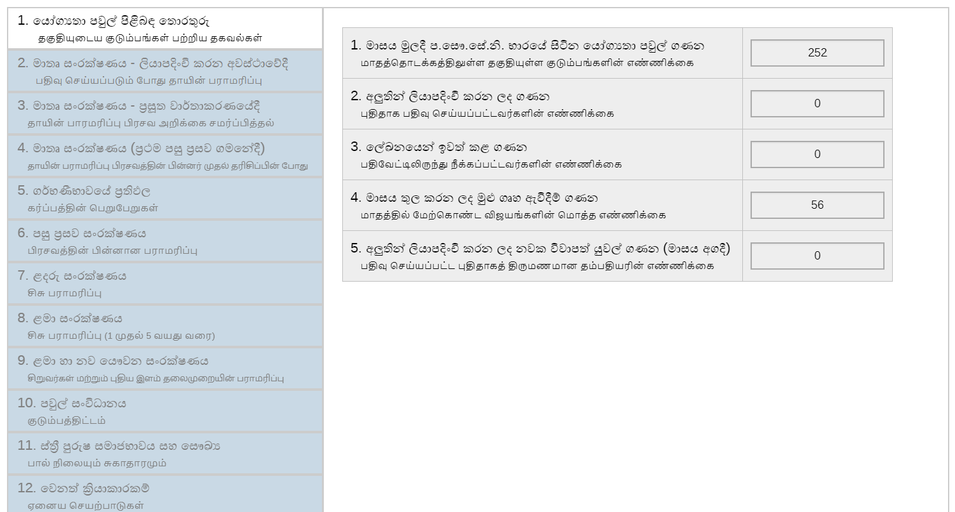
Form Designing

Slide 5
Form Designing
Optimization
For not well-established dataflows. (eg. Mental health, School health)
Paper-based forms reviewed and optimized prior to put it in DHIS2

Slide 6
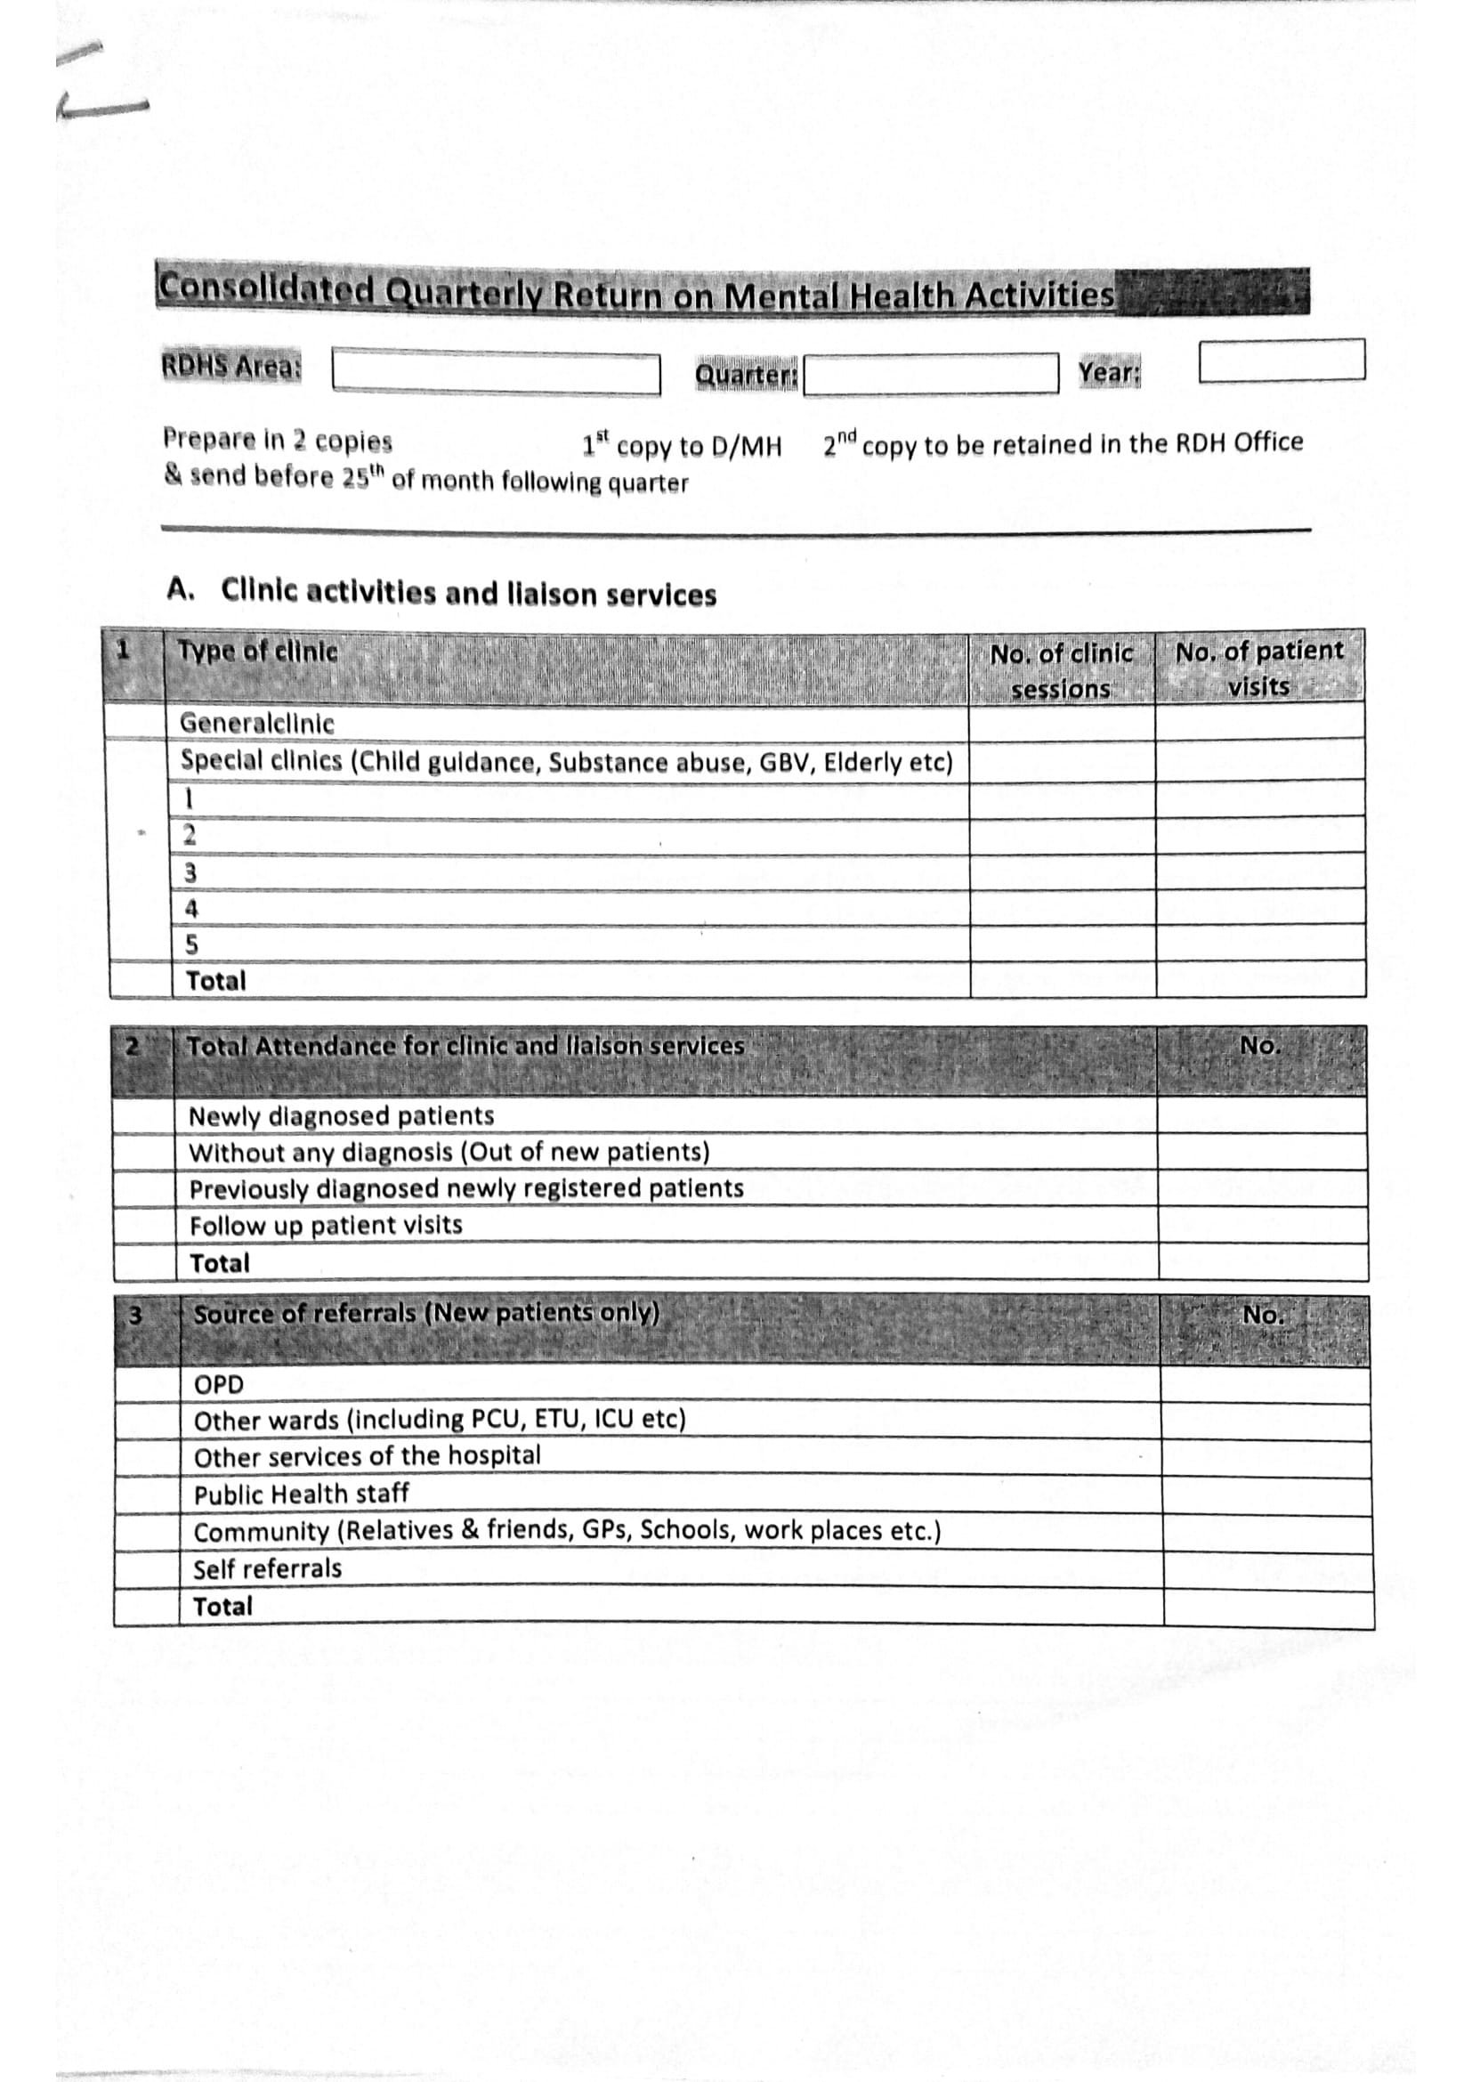
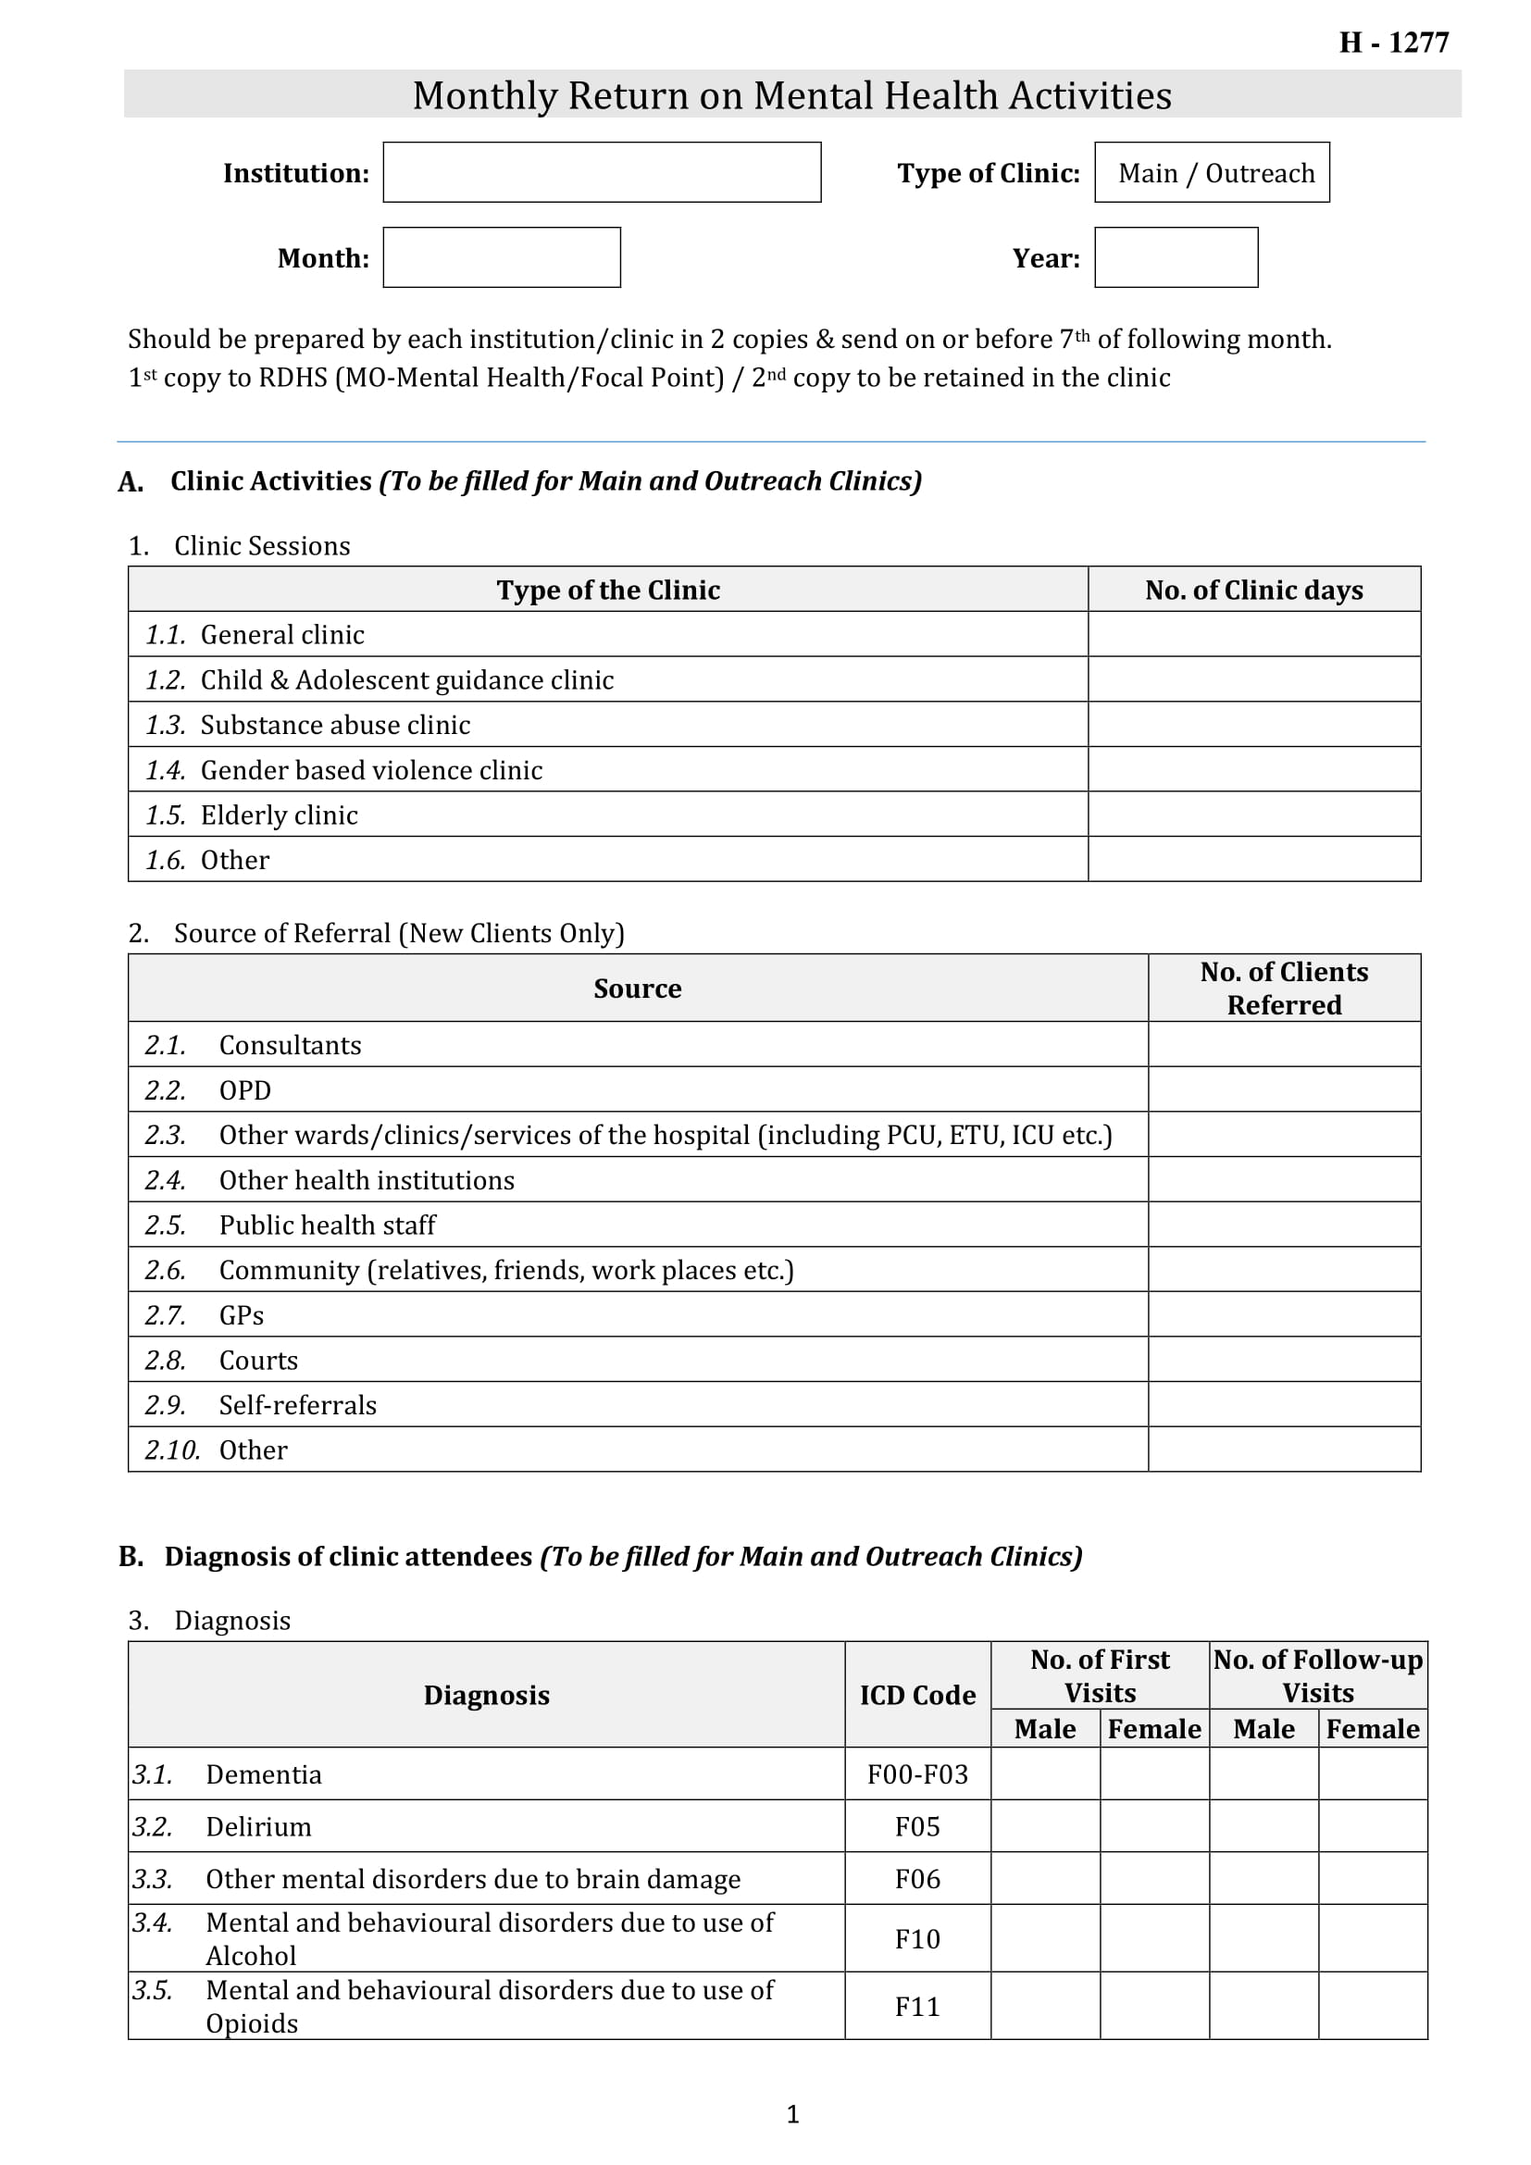
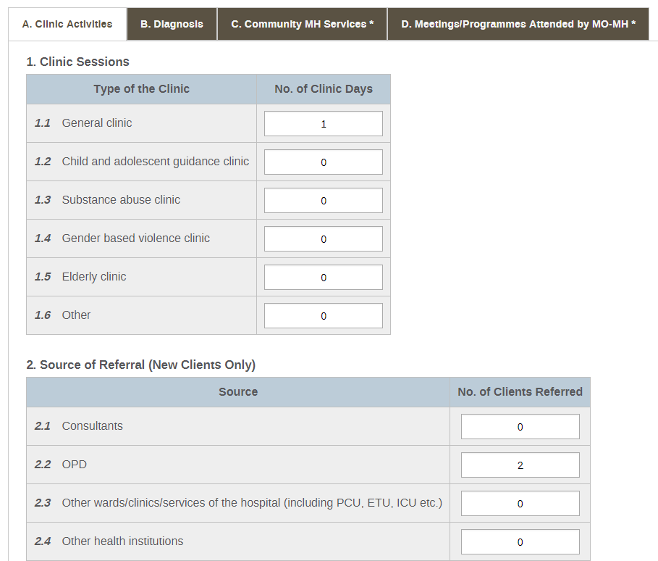

Slide 7
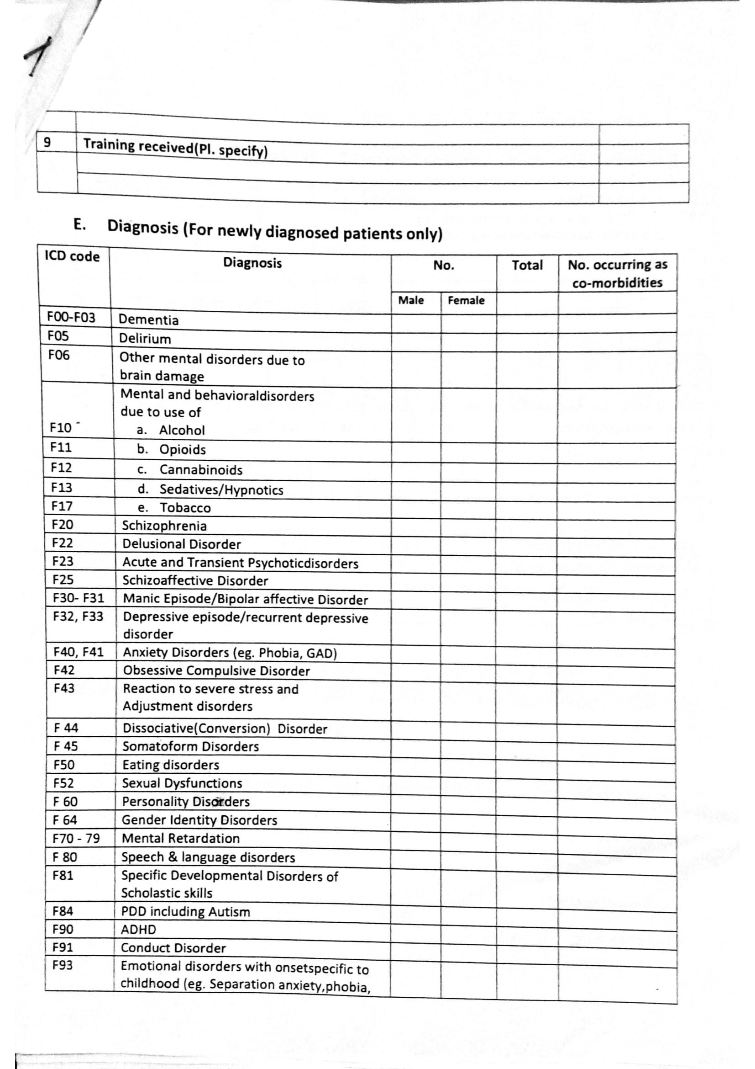

Slide 8
Form Designing
Redesigned / Newly designed
For new data flows

Slide 9
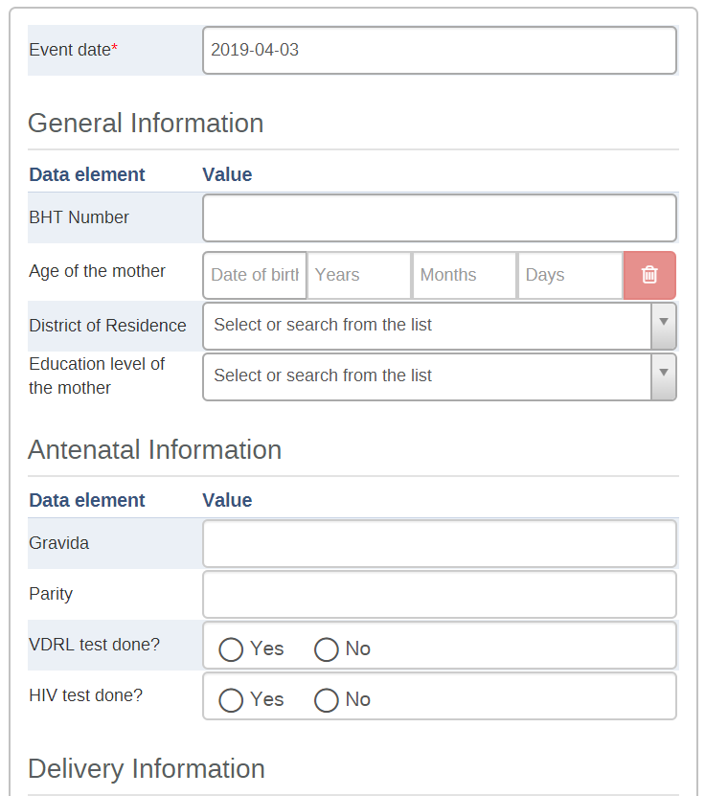
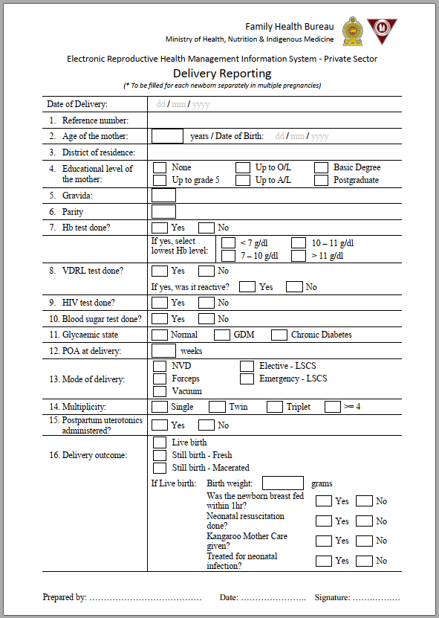

WHO MNH Indicators (19)

Slide 10
Workflow Designing
Preserving paper-based format at the level of data capturing
Minimum disturbances for service providers
Concerns on infrastructure facilities
Approval workflow to match the real-world scenario

Slide 11
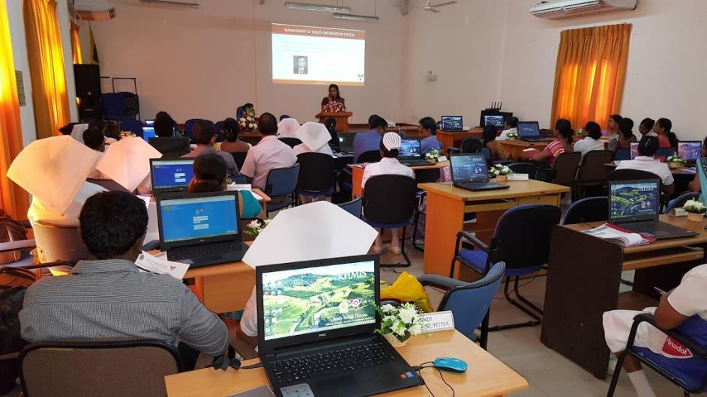
User Trainings

Slide 12
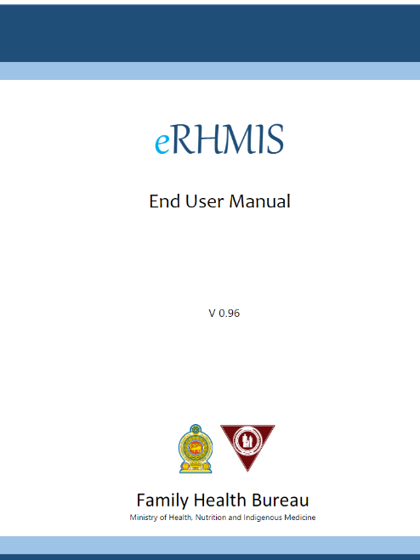
User Manual

Slide 13
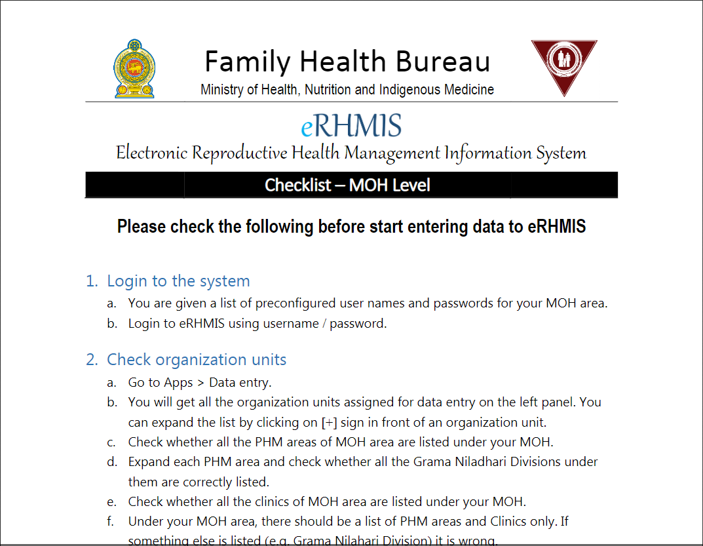
SOPs

Slide 14
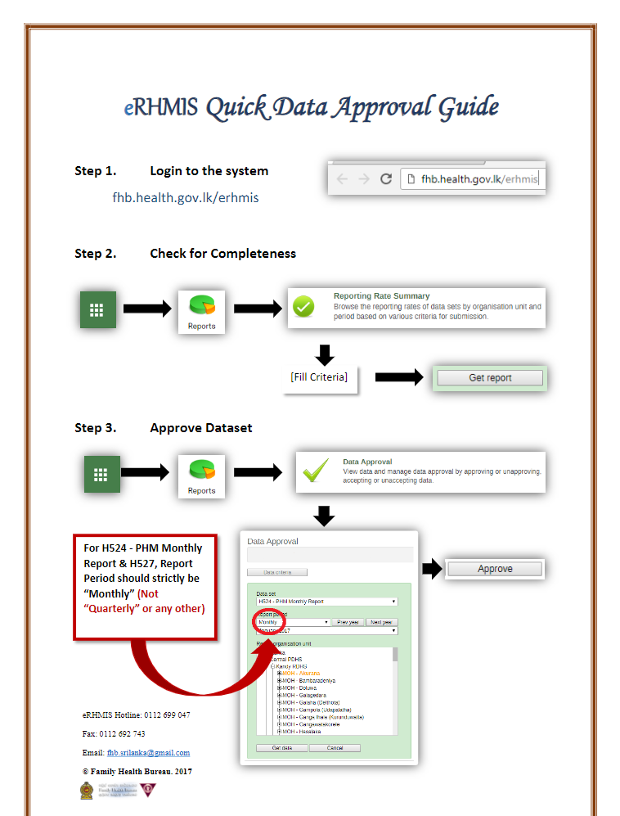
SOPs

Slide 15
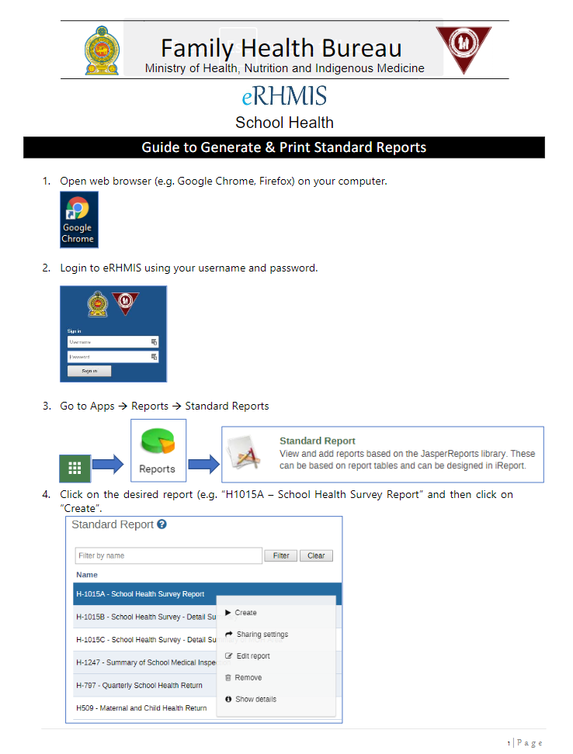
SOPs

Slide 16
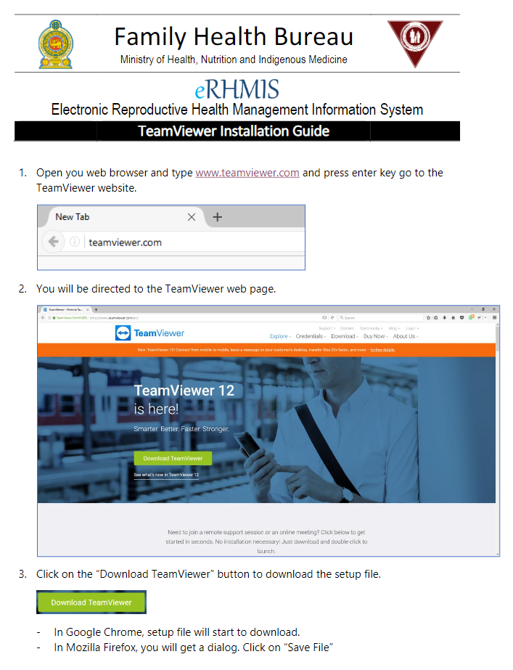
SOPs

Slide 17







User Support – 3 tier model
Tier 3
Tier 1
CCP
Tier 2
MO
ICTO
MOHI
User

Slide 18
Data Quality in DHIS2
Validation Rules - implemented
Compulsory Data Elements - implemented
Min-max
Predictors
WHO DQ tool
Score card
Legends
In the process

Slide 19
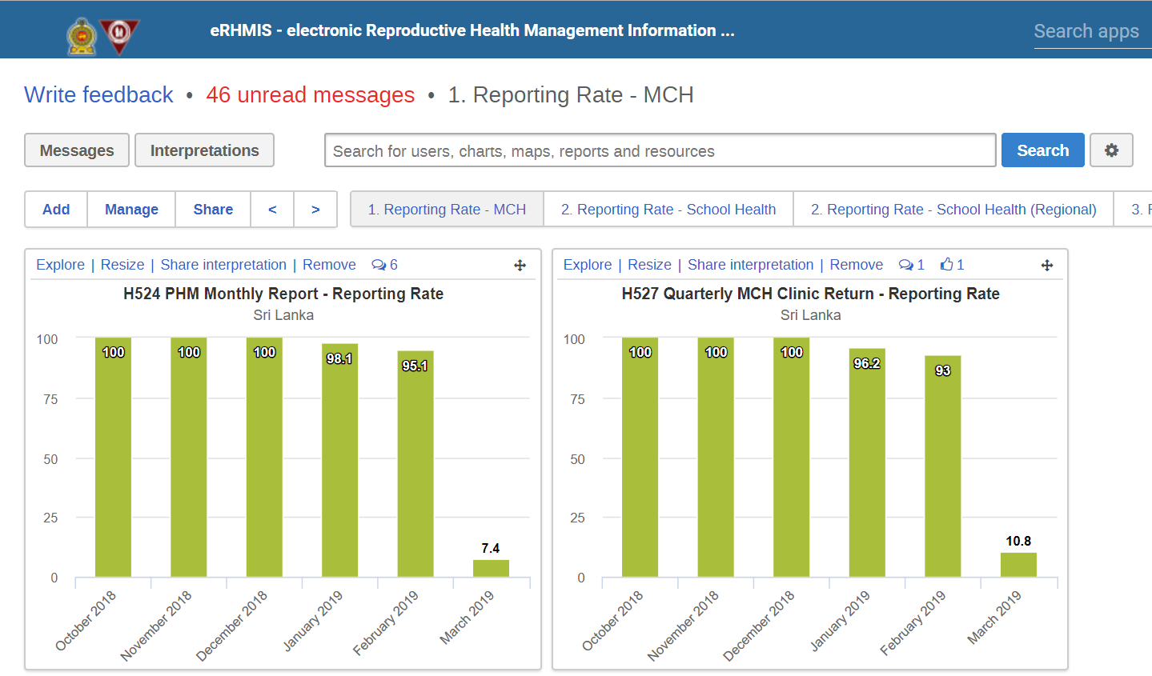
Review and Feedback
Monitoring Dashboards

Slide 20
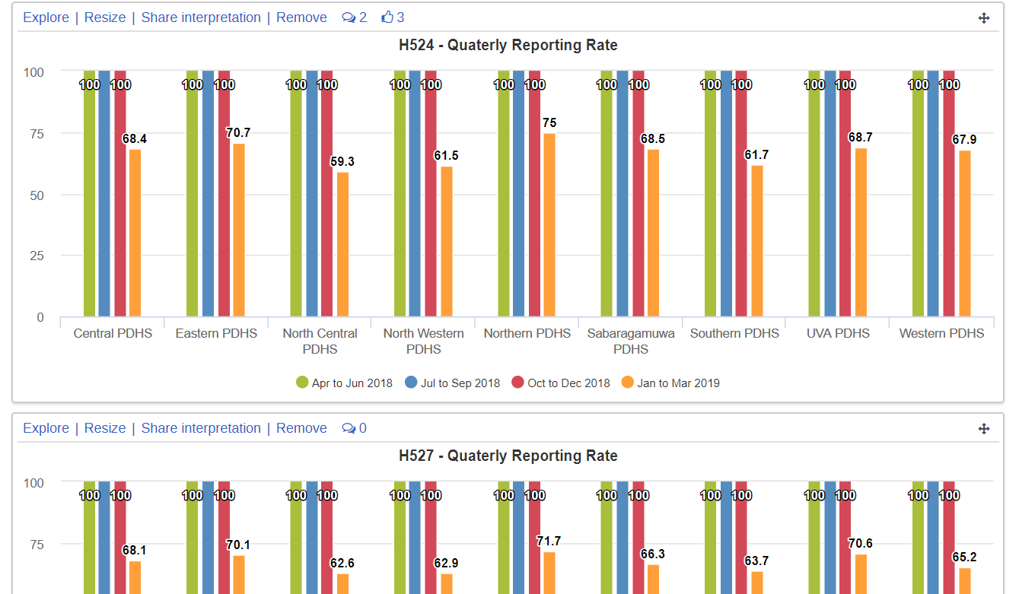
Review and Feedback
Monitoring Dashboards

Slide 21
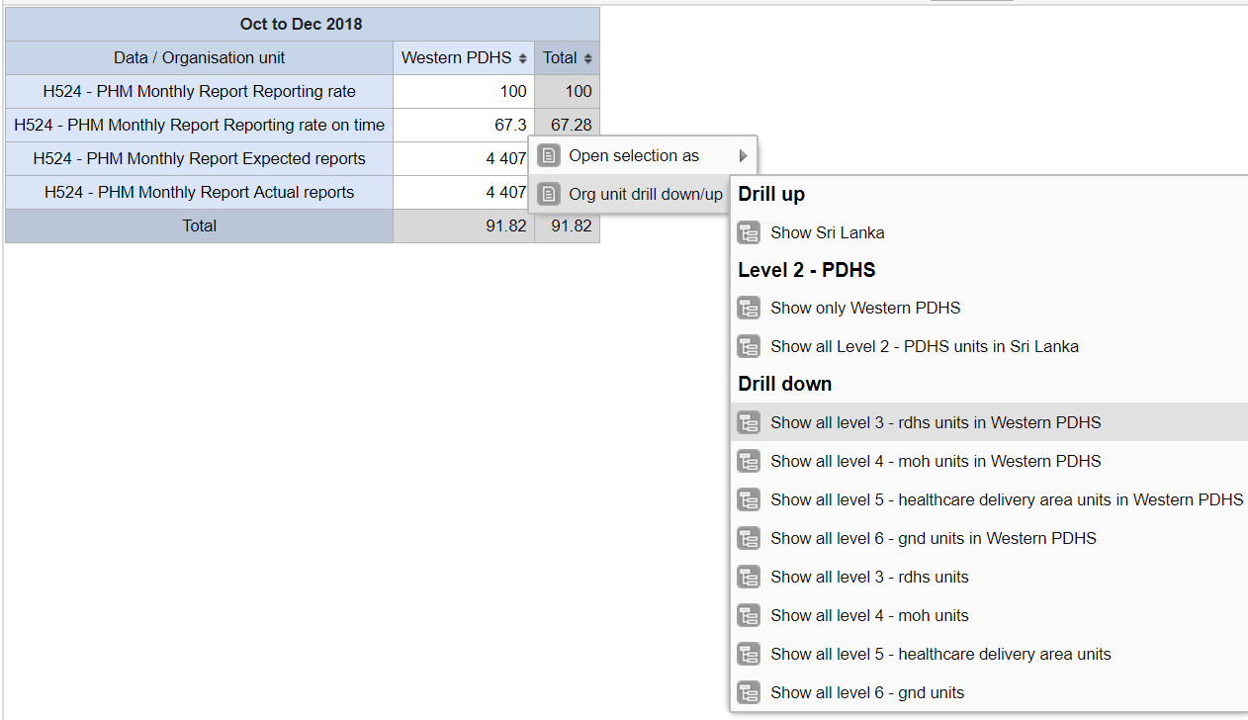
Review and Feedback
National Level Desk Reviews

Slide 22
Review and Feedback
Regular reviews
MCH Review at PHM level – Monthly
MCH Review at MOH level – Monthly
MCH Review at RDHS level – Yearly
MCH Review at country level – biannually

Slide 23
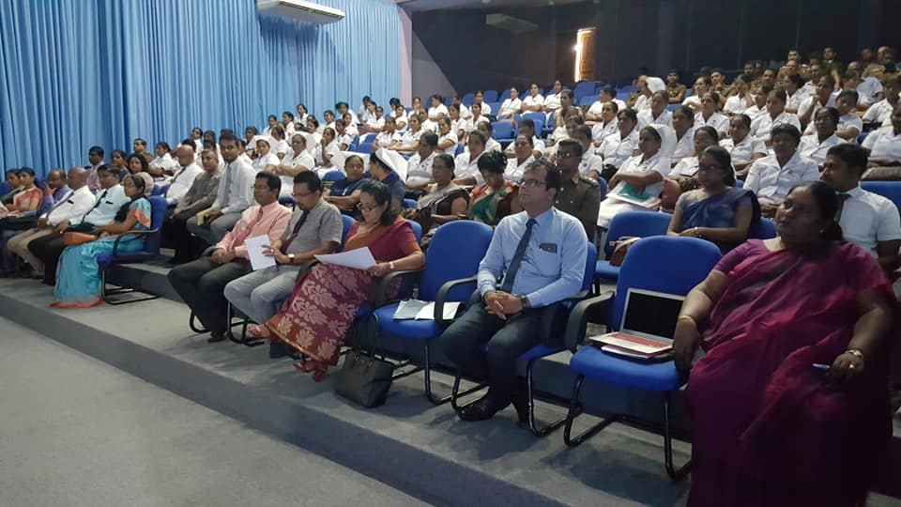
Reviews

Slide 24
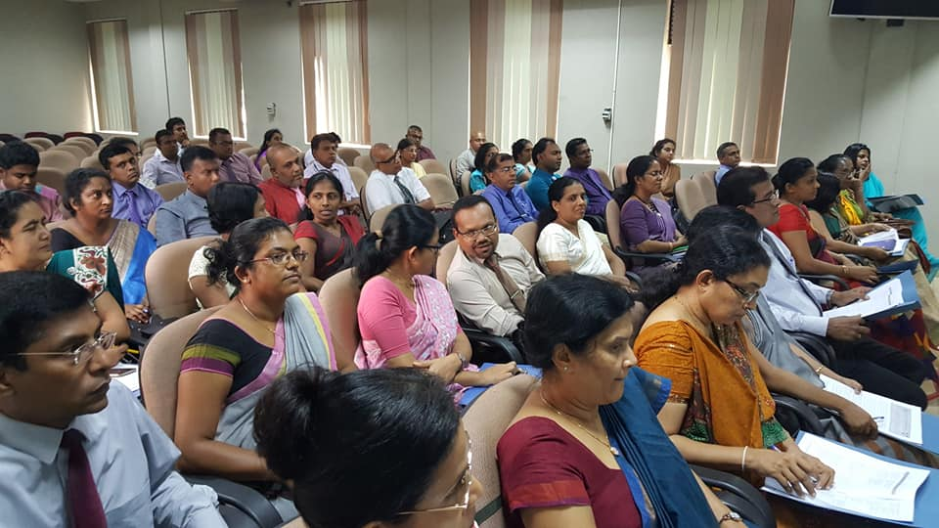
Reviews

Slide 25
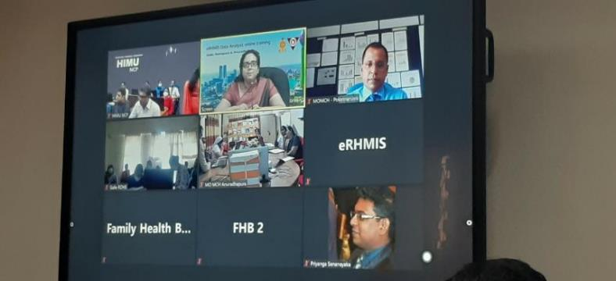
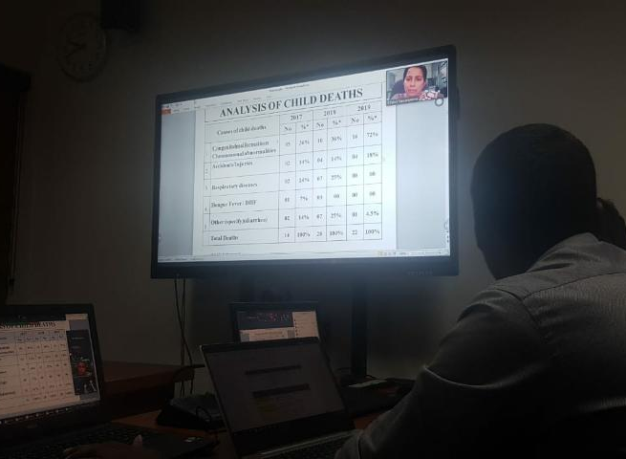
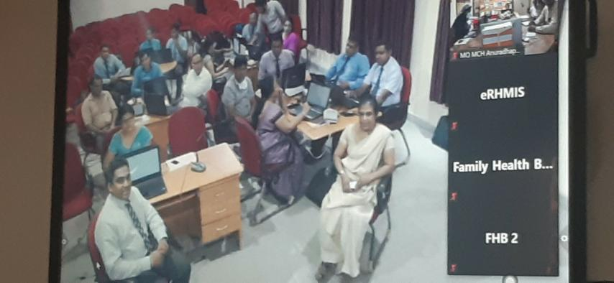
During the COVID-19 Pandemic

Slide 26

Feedbacks
Annual Report

Slide 27

Feedbacks
Quarterly Return

Slide 28
District Nutrition Monitoring System Personalized Monitoring of Children in the Community
Pamod Amarakoon
HISP Sri Lanka

Slide 29
Functionality
Register children with malnutrition at field level
Routinely monitor and track,
Nutritional parameters (height, weight)
Household risk factors
Obtain household geo locations
Analytics and chart visualizations for mobile user
Synchronize with central server and share with multi-sector stakeholders

Slide 30




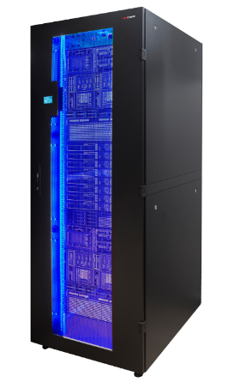
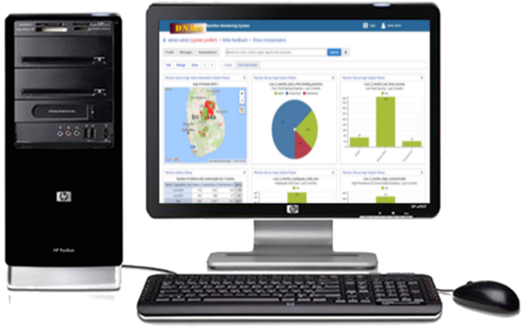
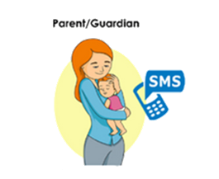


Slide 31
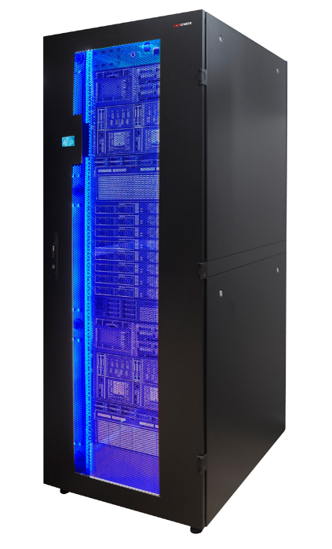

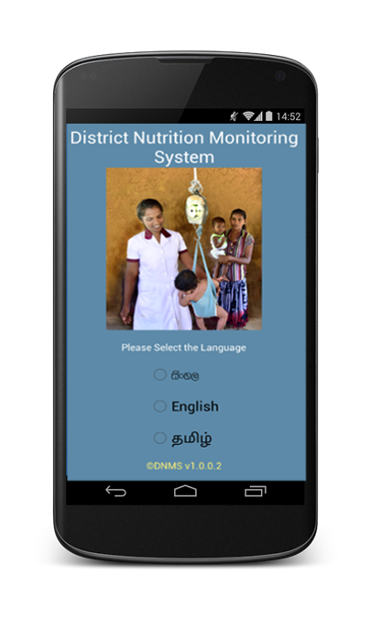
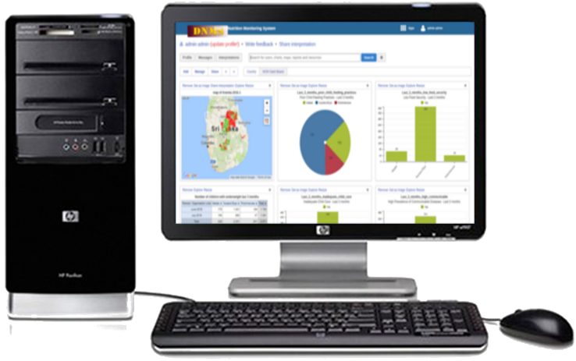
Technology
Web API

Slide 32
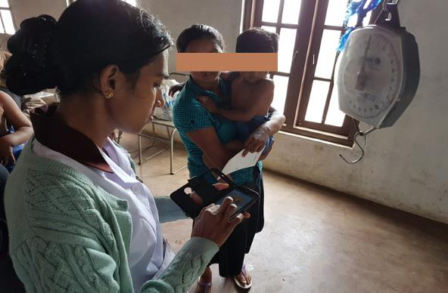
DQ Measures During Data Capture

Slide 33
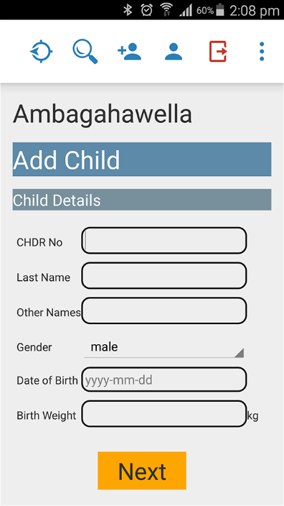
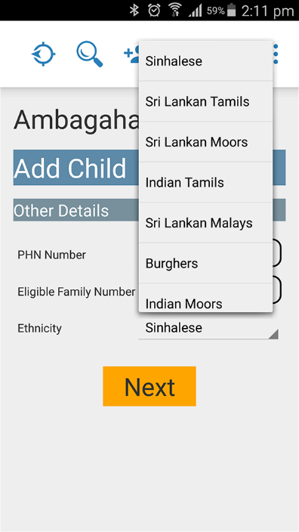
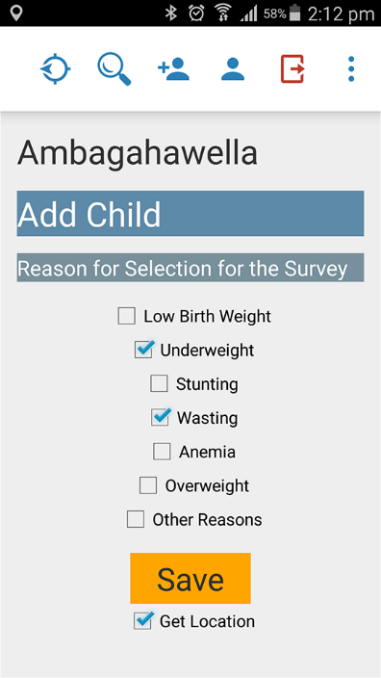
Simple Interfaces

Slide 34
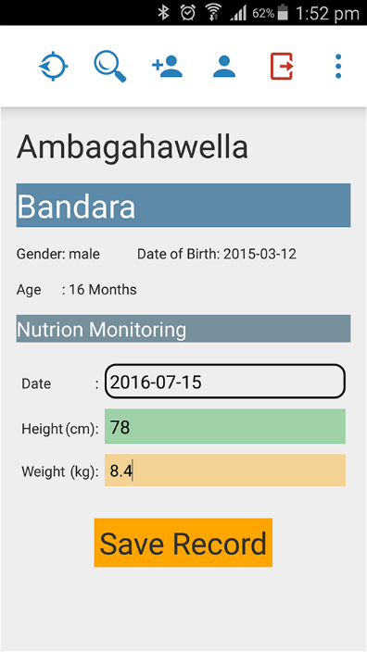
Real-time Validation of Entered Data
Height/weight data entry. Supports colour coding as you type it based on WHO reference ranges

Slide 35
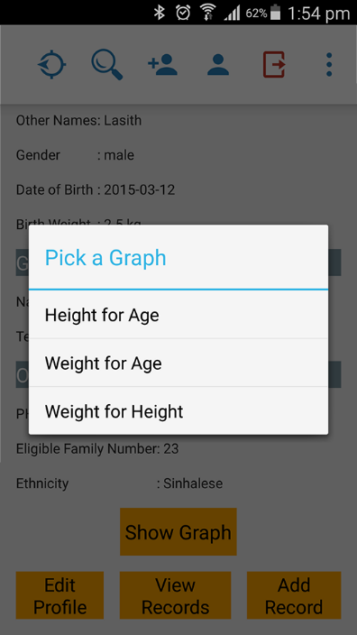
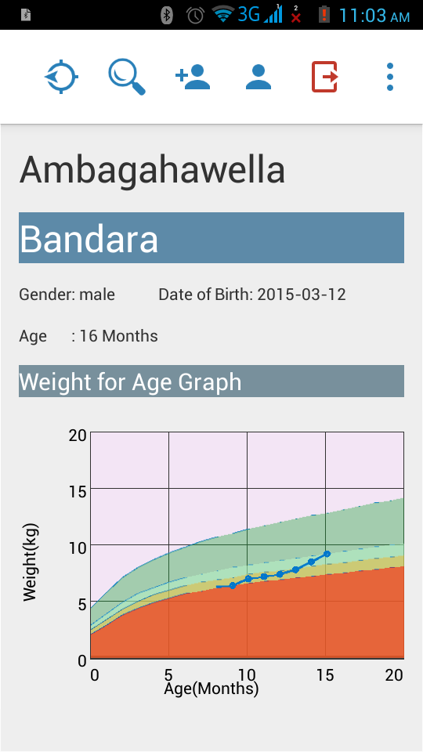
Display of longitudinal charting.
Multiple dimensions supported
Longitudinal charting with snapshot view of nutritional status and trend with use of reference colours

Slide 36
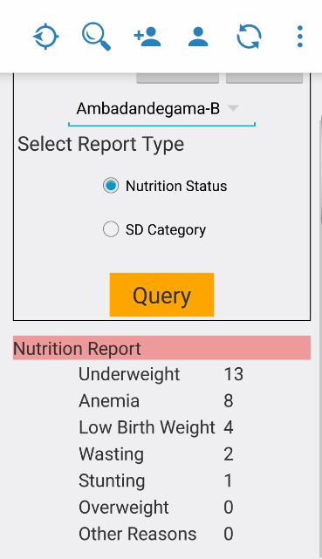
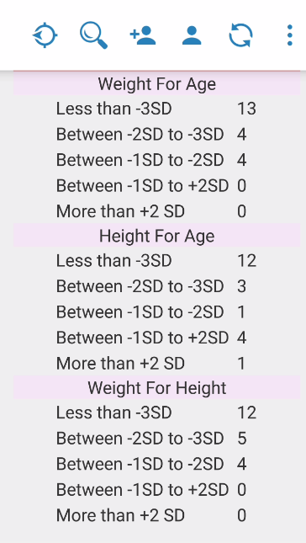
User Level Analytics
Generation of reports based on nutritional problem
&
height/weight measurements

Slide 37
DQ Measures at Facility Level

Slide 38
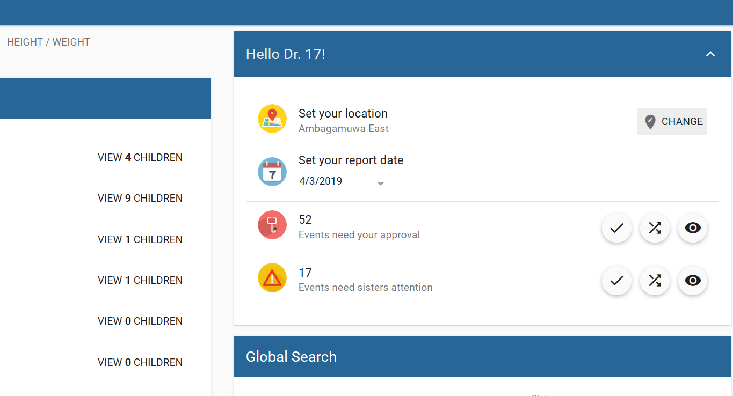
Supervision of Data by PHNS

Slide 39
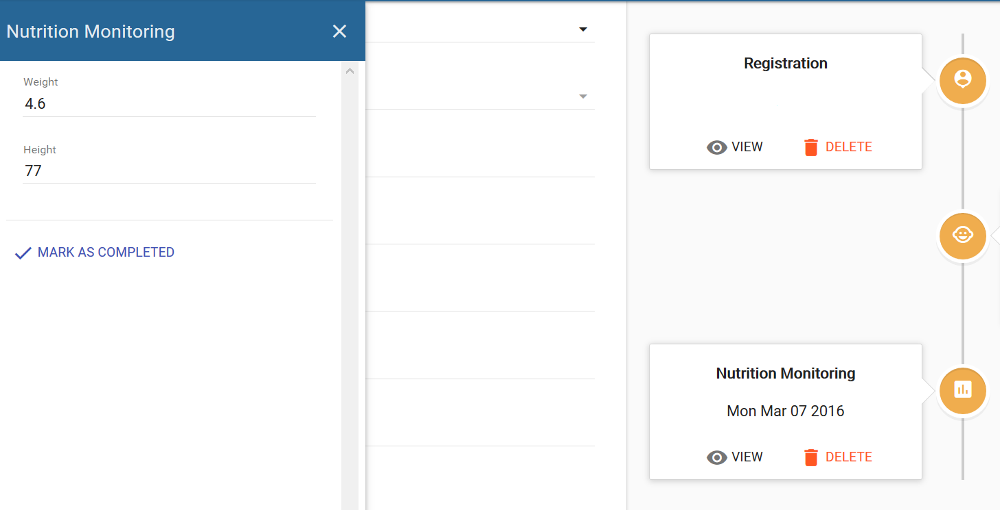

Slide 40
DQ Measures at MOH Level
Data Approval at MOH Level

